Slide 1
Will It Rain Tomorrow?
Application of Data Mining Techniques for Forecasting Rainfall in Yerevan
Group 5 presenters:
Maria Davoodian
Naira Matosyan
Silva Arakelyan
Anna Baghumyan
Arusyak Hakobyan
Instructor:
Sean Reynolds

Slide 2
Agenda
Aim and methodology
Geographical location of Yerevan
Relationship between parameters
Rainfall prediction practice
Q&A

Slide 3
Our aim
… is to predict the rainfall in Yerevan based on the weather data from 2017

Slide 4
Methodology

Slide 5
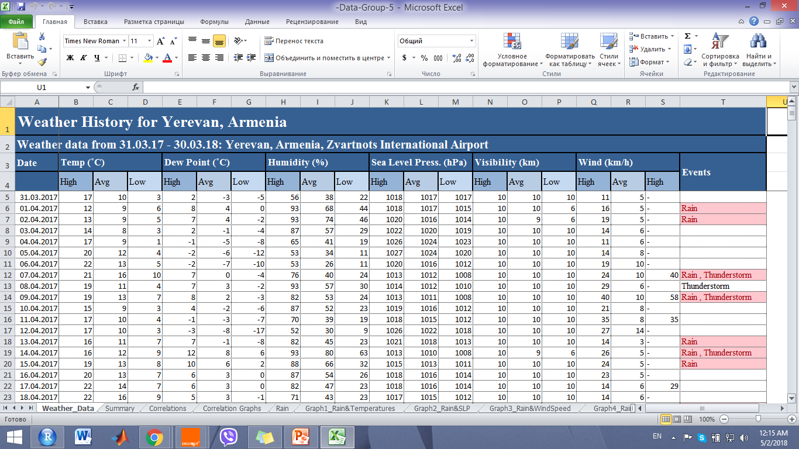
1. Data Preparation and Summarizing

Slide 6
1. Data Preparation and Summerizing

Slide 7
2. Visualization

Slide 8
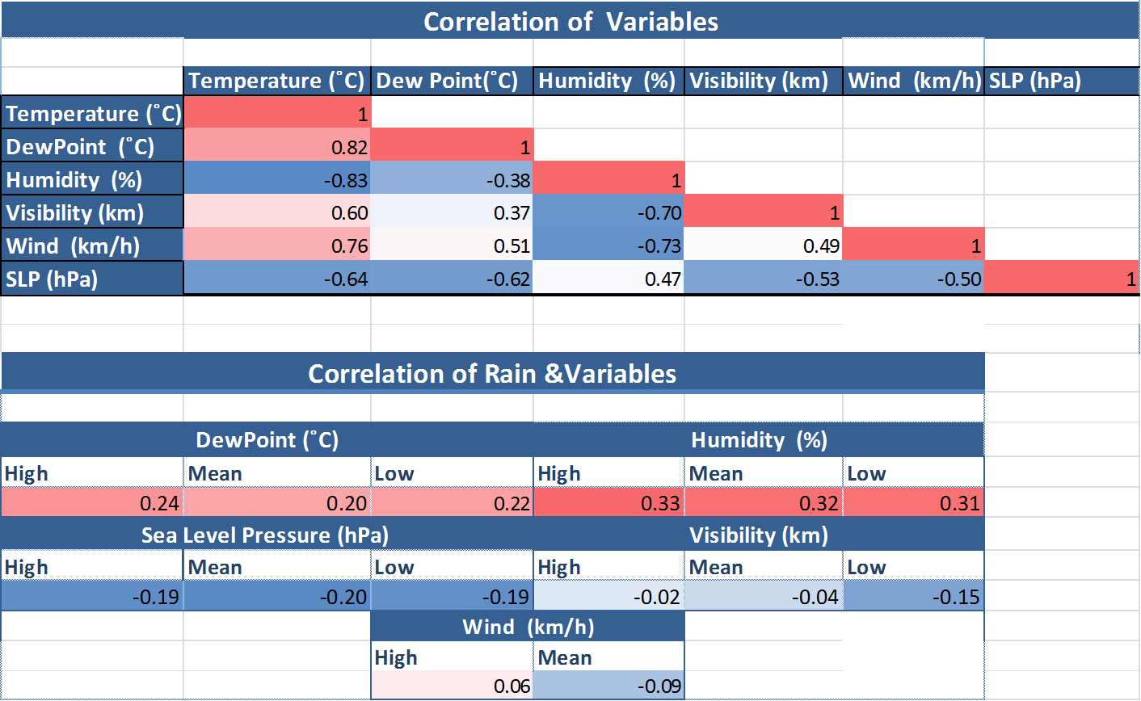
3. Analyzing Initial Patterns

Slide 9
4. Modeling and prediction
Statistical methods:
Naïve Bayes
Decision Trees
K-Nearest Neighbors

Slide 10
geographical Location of Yerevan
Which geographical characteristics matter?
Climate classification: What kind of climate does Yerevan have?

Slide 11
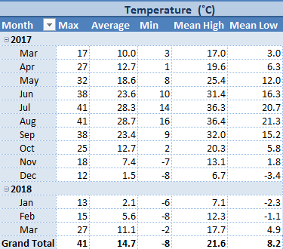
Köppen climate classification cold semi-arid climate
1. Warm to hot dry summers
2. Cold winters, carrying snowfall
and freezing temperatures

Slide 12
 | Number of Rained Days/ Portion
January | 9 | 0.3
February | 7 | 0.3
March | 15 | 0.0
April | 9 | 0.3
May | 15 | 0.5
June | 8 | 0.3
July | 6 | 0.2
August | 3 | 0.1
September | 3 | 0.1
October | 11 | 0.4
November | 11 | 0.4
December | 6 | 0.2
Long, hot, dry summers
Short, cold, relatively
wet winters
Even wetter springs
and autumns

Slide 13
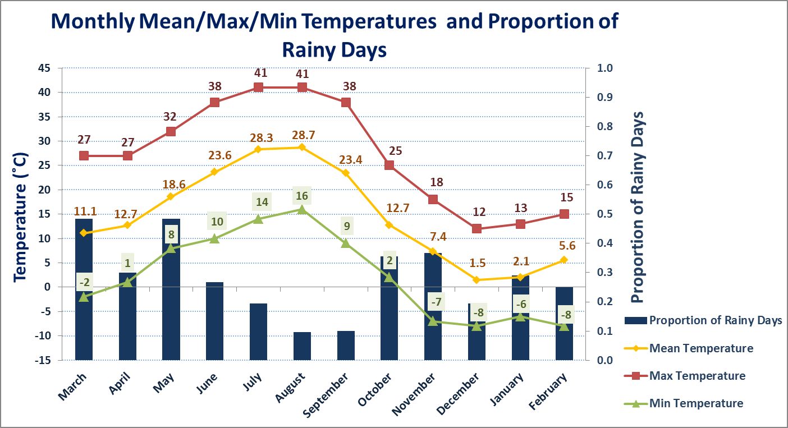
Monthly Temperature

Slide 14
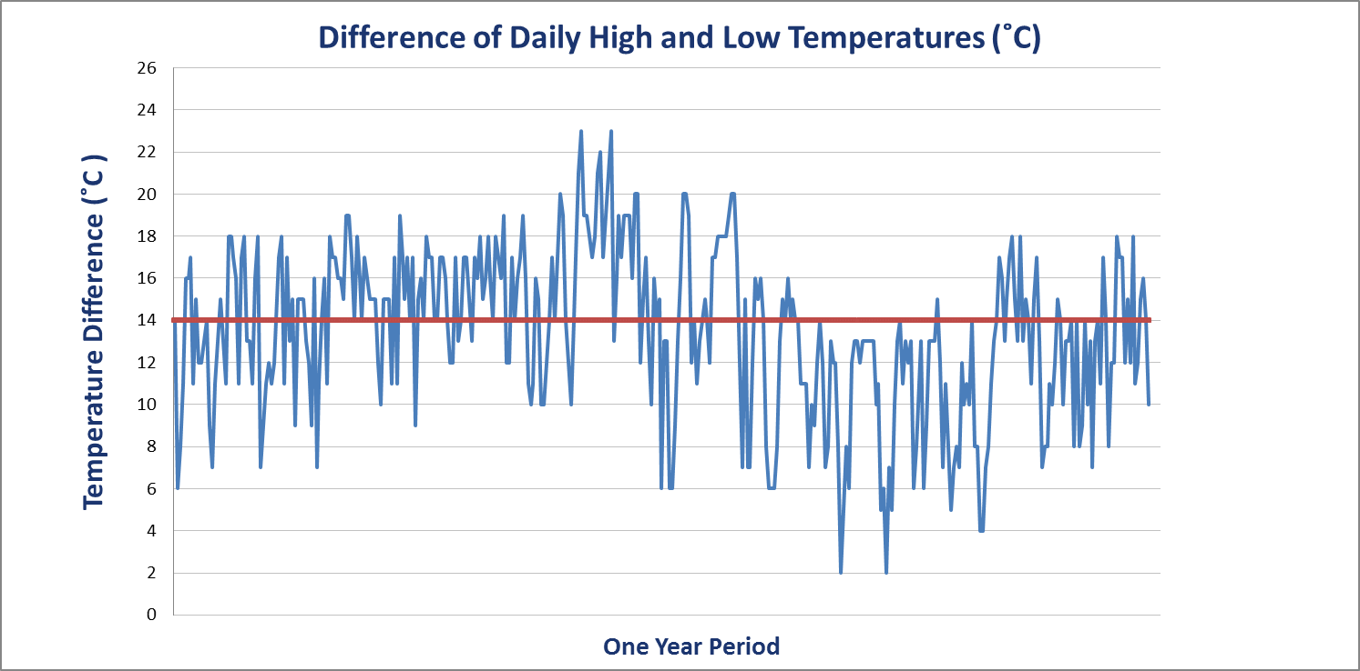
3. Large Diurnal Temperature Variations

Slide 15
Relationship between Parameters
Which factors influence rainfall?
Rainfall and:
Temperature
Wind Speed
Pressure
Humidity

Slide 16
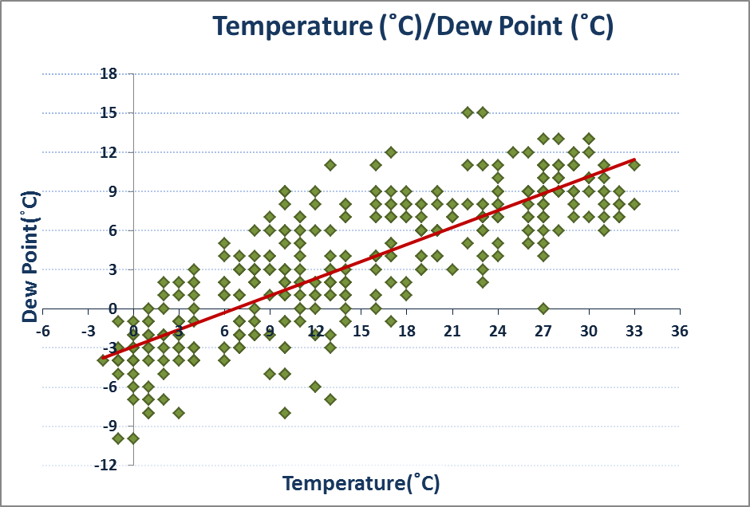
Temperature and Dew Point
Changes in air temperature are linked to changes in relative humidity
The dew point varies less than the temperature
When the air temperature becomes the same as the dew point, rain is likely to fall

Slide 17
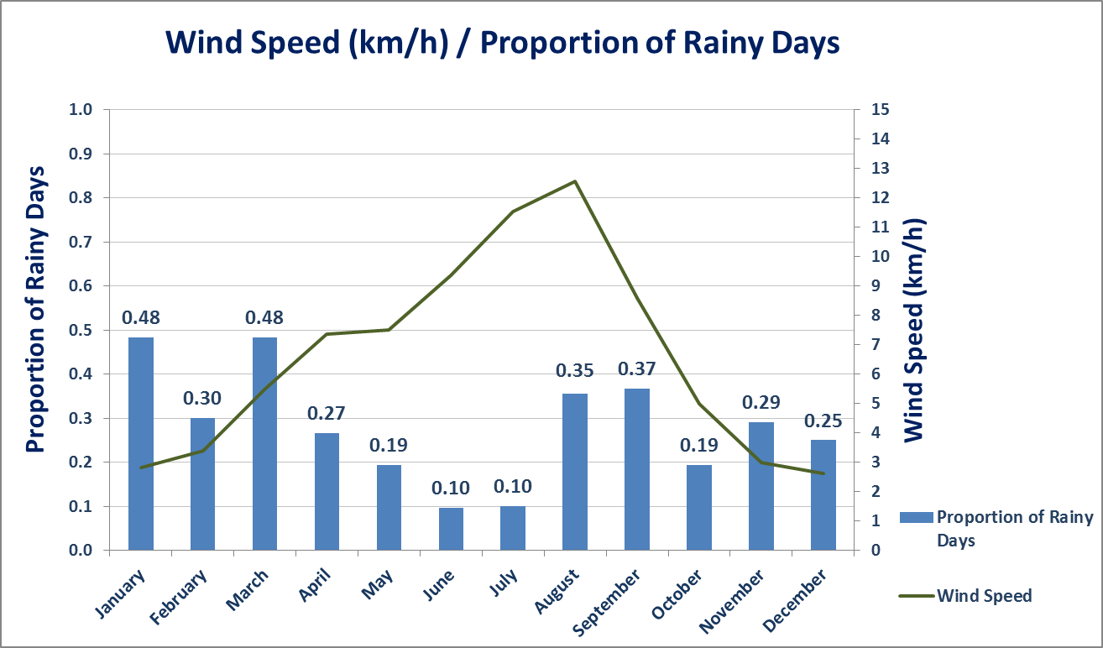
Wind Speed and Rainfall
The rainfall loss rate increases when the wind speed increases and/or rainfall intensity decreases

Slide 18
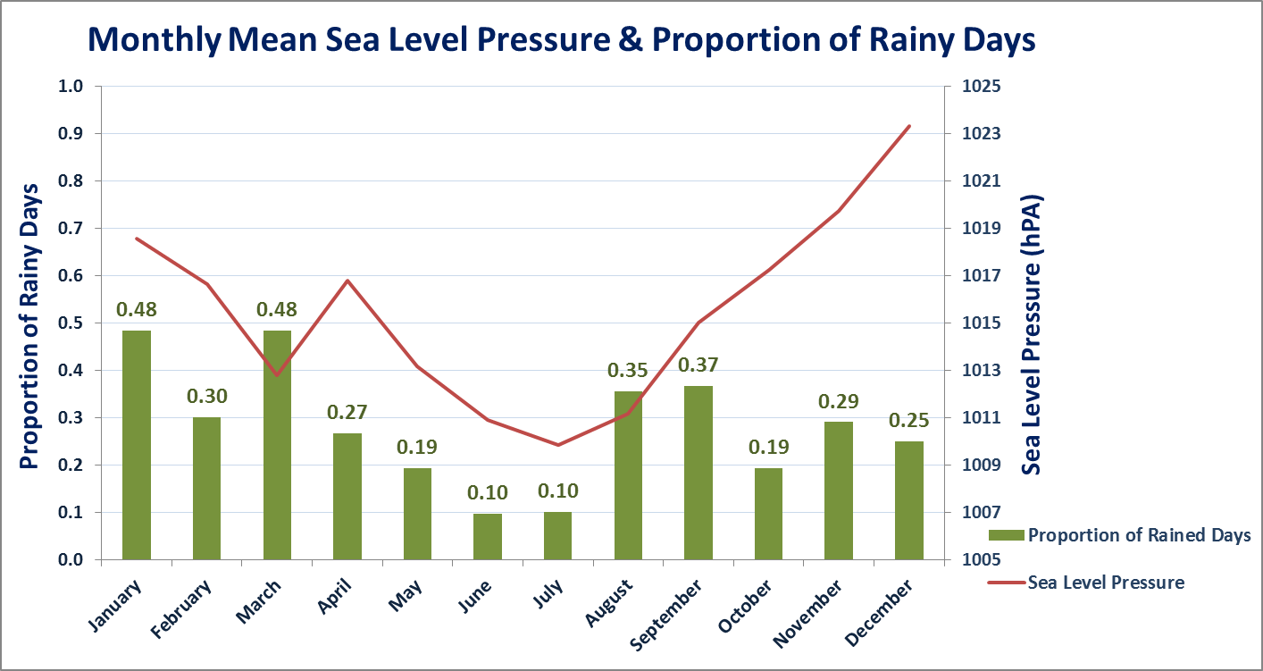
Pressure and Rainfall
When the atmospheric pressure falls, rainfall occurs
When the atmospheric pressure is high, rainfall is unlikely
 | SLP(hPa)
January | 1018.55
February | 1016.64
March | 1012.77
April | 1016.80
May | 1013.16
June | 1010.90
July | 1009.84
August | 1011.16
September | 1015.00
October | 1017.23
November | 1019.73
December | 1023.32

Slide 19
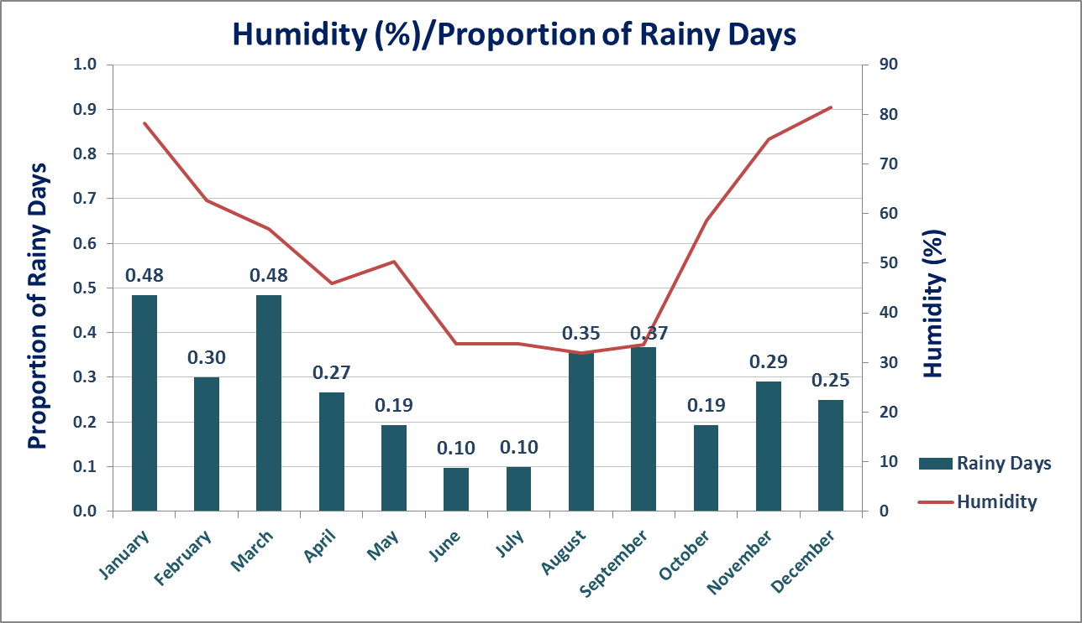
Humidity and Rainfall
If the relative humidity of the air below clouds is high – Increased rainfall
If the humidity of the air is low – Reduced rainfall

Slide 20
Rainfall Prediction
What do we need?
Decision Trees: What are they and how they can be used to predict rainfall?

Slide 21
Simple Example
Height(cm) | Weight(kg) | Sex
182 | 85 | Male
185 | 90 | Male
165 | 55 | Female
163 | 56 | Female
175 | 84 | Male
168 | 64 | Female
155 | 47 | Female
170 | 82 | Male
180 | 71 | Female
187 | 88 | Male
Can you guess the gender of the next person based on their height and weight?

Slide 22
Decision Trees
Height >
180cm
Yes
No
Male
Weight >
80kg
Yes
No
Male
Female

Slide 23
Prediction Steps
Extract a patterns from the data
Make rules based on the patterns
Apply the rules to the new observation

Slide 24
Now, It’s Time for the Prediction!

Slide 25
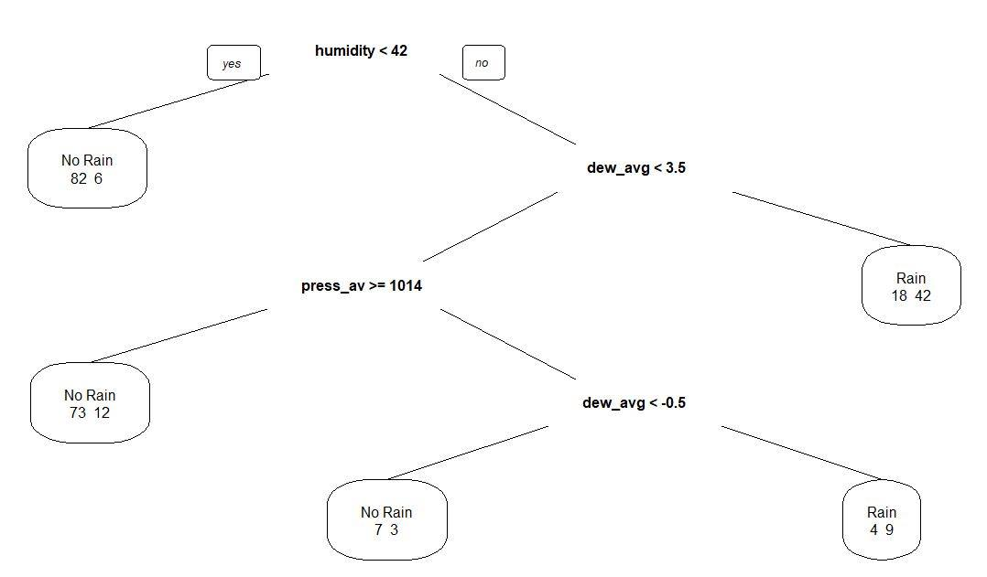
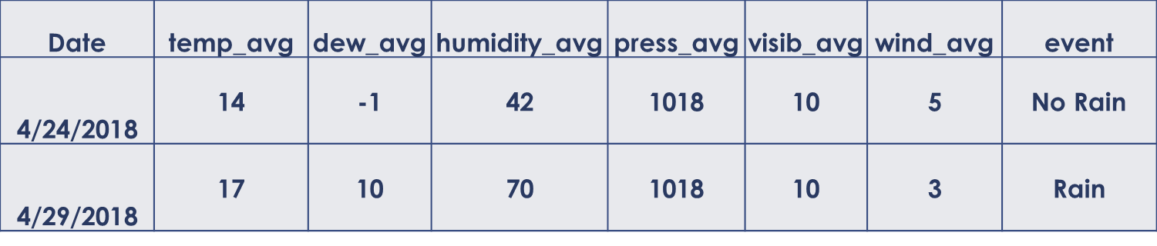
Rainfall Prediction

Slide 26
Thank you for your attention!
Q & A

Slide 27
References
Arun, C., Sheikh, F., Karthick, S., Malathi, D., Sudarsan, J. S. (2016). Analysis of Data Mining Techniques for Weather Prediction. Retrieved from http://www.indjst.org/index.php/indjst/article/viewFile/101962/74214
Cong, R.G., Brady, M. (2012). The Interdependence between Rainfall and Temperature: Copula Analyses.” The Scientific World Journal, vol. 2012, pp. 1–11., Retrieved from https://www.hindawi.com/journals/tswj/2012/405675/
Gupta, D., Ghose U. (2015). A Comparative Study of Classification Algorithms for Forecasting Rainfall. Retrieved from http://ieeexplore.ieee.org/stamp/stamp.jsp?arnumber=7359273
Olaiya, F., Adeyemo, A. B. (2012). Application of Data Mining Techniques in Weather Prediction and Climate Change Studies. Retrieved from http://www.mecs-press.org/ijieeb/ijieeb-v4-n1/IJIEEB-V4-N1-7.pdf
Hsu, S.H., Guo, Y.L. (2005). Effect of Wind Speed on the Measurement of Rainfall. pp. 81–86. Retrieved from http://web.tari.gov.tw/csam/CEB/member/publication/2(1)/008.pdf
Using Weather Measurements to Predict the Weather. (2009). Retrieved from http://www.e-missions.net/wvstorm/?cat=2&sid=1&pid=31&page=Understanding
Weather and Climate. (n.d.). Retrieved from http://www.weather-climate.org.uk/05.php
Yadav, R. K., Khatri, R. (2016). A Weather Forecasting Model using the Data Mining Technique. Retrieved from https://pdfs.semanticscholar.org/a49c/a96735e5e6f9bd0f51420489399588c3239c.pdf

